Slide 1
Hello Everyone Course Code : CSE201 Course Title : Data Structure
Course Teacher:
Md. Jamal Uddin
Assistant Professor
Department of CSE,BSMRSTU,
Gopalganj-8100.
Presented By:
Tushar Sarkar
Student ID: 18CSE035
Department of CSE,BSMRSTU,
Gopalganj-8100.

Slide 2
Selection Sort

Slide 3
Outline
Introduction to Sort
What is Selection Sort?
Algorithm Explain
Example of Selection Sort
Pseudo Code
Complexity
Advantages & Disadvantages
Conclusion

Slide 4
Introduction to Sort
Sorting is one of the most basic functions applied to data.
Sorting is a technique that is implemented to arrange the data in a specific order.
It means arranging the data in a particular fashion, which can be increasing or decreasing.
Sorting is required to ensure that the data which we use is in a particular order so that we can easily retrieve the required piece of information from the pile of data.
If the data is unkempt and unsorted, when we want a particular piece of information, then we will have to search it one by one every time to retrieve the data.

Slide 5
What is Selection Sort?
Selection sort is a simple sorting algorithm. ...
The smallest element is selected from the unsorted array and swapped with the leftmost element, and that element becomes a part of the sorted array.
This process continues moving unsorted array boundary by one element to the right.
The selection sort algorithm sorts an array by repeatedly finding the minimum element (considering ascending order) from unsorted part and putting it at the beginning. The algorithm maintains two subarrays in a given array

Slide 6
Algorithm Explain
Step 1 − Set MIN to location 0
Step 2 − Search the minimum element in the list
Step 3 − Swap with value at location MIN
Step 4 − Increment MIN to point to next element S
Step 5 − Repeat until list is sorted

Slide 7
Example of Selection Sort
If primary array is :
Sorting By Ascending Order :
Sorting By descending Order :
9 | 13 | 15 | 11 | 2
2 | 9 | 11 | 13 | 15
15 | 13 | 11 | 9 | 2

Slide 8
Example Explain
Iteration 1:
In terms of index 0 Index
arr[0]=9,arr[4]=2 Value
arr[0]>arr[4], swap(arr[0],arr[4]) & arr[0] is sorted.
Iteration 2:
In terms of index 1 Index
arr[1]=13,arr[4]=9 Value
arr[1]>arr[4], swap(arr[1],arr[4]) & arr[1] is sorted.
0 | 1 | 2 | 3 | 4
9 | 13 | 15 | 11 | 2
0 | 1 | 2 | 3 | 4
2 | 13 | 15 | 11 | 9

Slide 9
Example Explain
Iteration 3:
In terms of index 2 Index
arr[2]=9,arr[3]=2 Value
arr[2]>arr[3], swap(arr[2],arr[3]) & arr[2] is sorted.
Iteration 4:
In terms of index 3 Index
arr[3]=15,arr[4]=13 Value
arr[3]>arr[4], swap(arr[3],arr[4]) & arr[3] is sorted.
0 | 1 | 2 | 3 | 4
2 | 9 | 15 | 11 | 13
0 | 1 | 2 | 3 | 4
2 | 9 | 11 | 15 | 13

Slide 10
Example Explain
Iteration 5:
In terms of index 4 Index
Here present iterate is last index Value
So no iterate & already array is sorted.
Finally Sorted array is :
Index
Value
0 | 1 | 2 | 3 | 4
2 | 9 | 11 | 13 | 15
0 | 1 | 2 | 3 | 4
2 | 9 | 11 | 13 | 15

Slide 11
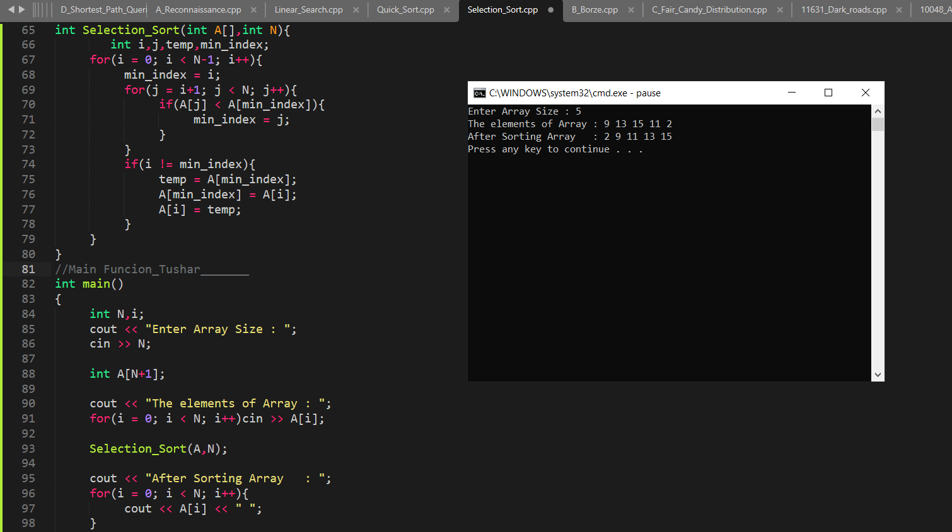
Pseudo Code
.

Slide 12
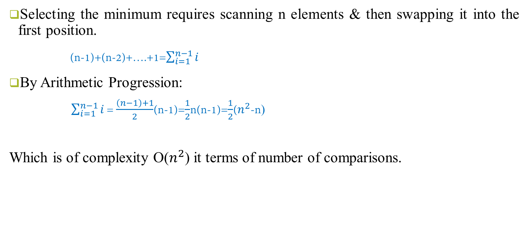
Complexity
Selecting the minimum requires scanning n elements & then swapping it into the first position.
(n-1)+(n-2)+….+1=$\sum_{i=1}^{n−1}{i}$
By Arithmetic Progression:
$\sum_{i=1}^{n−1}{i}$ = $\frac{\left(n−1\right)+1}{2}$(n-1)=$\frac{1}{2}$n(n-1)=$\frac{1}{2}$($n^{2}$-n)
Which is of complexity O($n^{2}$) it terms of number of comparisons.

Slide 13
Advantages of Selection Sort
Easy to implement;
Requires no additional storage space.
It performs well on a small list.

Slide 14
Disadvantages of Selection Sort
Poor efficiency when dealing with a huge list of items
Its performance is easily influenced by the initial ordering of the items before the sorting process.

Slide 15
Conclusion
Selection sort is sorting algorithm known by its simplicity.
Unfortunately, it lacks efficiency on huge lists of items, and also, it does not stop unless the number of iterations has been achieved (n-1, n is the number of elements) even though the list is already sorted.

Slide 16
Thank You

